Slide 1
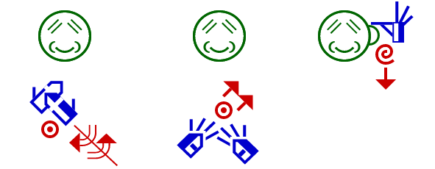
Signwriting Project in Tunisia

Slide 2
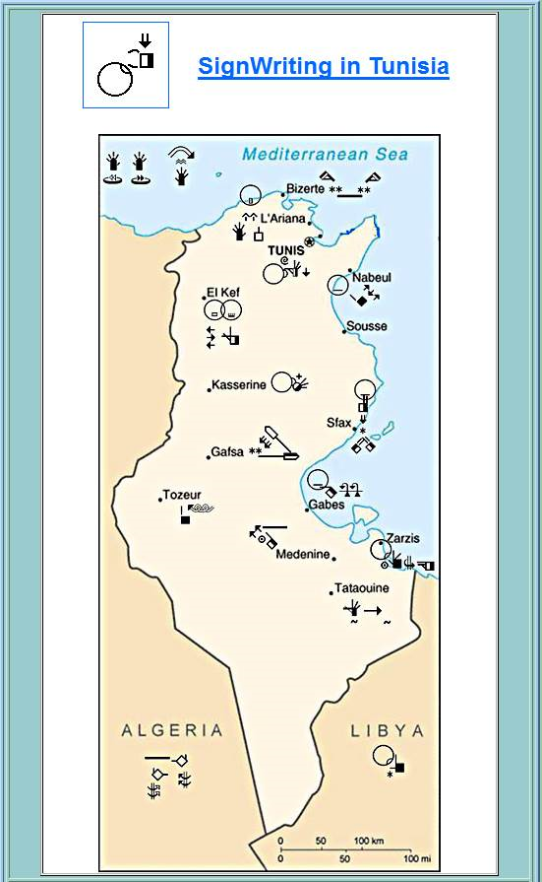
Tunisia’s Towns Map

Slide 3
Visit Tunisia’s Signwriting Page http://www.signwriting.org/tunisia/

Slide 4
Free Online Tunisian Sign language Dictionary and Literature
The dictionary and the literature are a continuous work in order to make a reference data to the deaf and to the sign language learner.
Signwriting dictionary is also helpful to those who will be meeting Tunisian deaf so that they can have a successful cross-cultural meeting.

Slide 5
SignWriting Teaching Manual http://www.signwriting.org/archive/docs9/sw0823_AR_Cross_Linguistic_Guide_To_SignWriting_Arabic_Translation.pdf
This is the translation of dear Parkhurst’s Signwriting manual which has been translated into Arabic with some changes of the up-dated new hand shapes and the adding of Tunisian signs so that the Tunisian sign language learner might understand better.
It can be downloaded for free.

Slide 6
Tunisian Signwriting Workbook https://www.dropbox.com/s/xckhd6lm6sat7rw/SW%20workbook%20numbered.pdf
This is the first Tunisian Signwriting workbook which can be downloaded for free. It is written in both French and Arabic languages so that much people can benefit.
It contains further explanations, texts reading and comprehension, different kinds of exercices, cartoon pages, etc…

Slide 7
Signwriting 120 Hand Shapes http://www.signwriting.org/archive/docs10/sw0932_TN_SignWriting_Hand_Symbols_Tunisian_Sign_Language.pdf
This is a selective book in which one can find the 120 most used hand shapes in Tunisian and French sign languages. These hand shapes are selected from Valerie Sutton and Adam Frost’s hand shapes book where Adam used his own hands when making the book.
The 120 hand shapes book is translated into Arabic and French.
It can be downloaded for free.

Slide 8
Gospel Of Luke’s Project
This is a sample page of Luke’s Gospel translated into sign language.
It is a long path to go through in order to bring the Gospel to deaf people in their own language.
The Gospel of Luke has not been finished yet, and you can find it on Tunisian Signwriting Literature page.
This page is for Chapter4 and verse 14 (Lk4:14).

Slide 9
Celebrities' Biographies
Martin Luther King
Aboul Kacem Chebbi

Slide 10
Children Stories in Signwriting

Slide 11
The Fox & The Little Bird https://www.facebook.com/photo.php?fbid=519232084843754&set=a.519232044843758.1073741850.330099553757009&type=1&theater
Stories
For
Children
In
Signwriting

Slide 12
Goldilocks Levels (1, 2 & 3) http://www.signwriting.org/archive/docs10/sw0933_TN_Goldilocks_Storybook_SWLevel3_Tunisian_Sign_Language.pdf
Stories
For
Children
In
Signwriting

Slide 13
The Crow & The Wolf https://www.facebook.com/photo.php?fbid=519215508178745&set=a.519215418178754.1073741848.330099553757009&type=1&theater
Stories
For
Children
In
Signwriting

Slide 14
The Drawing Competition https://www.facebook.com/photo.php?fbid=519176018182694&set=a.519175944849368.1073741847.330099553757009&type=1&theater
Stories
For
Children
In
Signwriting

Slide 15
The Cricket & The Ant https://www.facebook.com/photo.php?fbid=519216024845360&set=a.519215831512046.1073741849.330099553757009&type=1&theater
Stories
For
Children
In
Signwriting

Slide 16
The True Christmas Story http://www.signwriting.org/archive/docs10/sw0931_TN_Christmas_Story_Tunisian_Sign_Language.pdf
Stories
For
Children
In
Signwriting

Slide 17
The Dog & The Two Cats https://www.facebook.com/photo.php?fbid=470507289716234&set=pb.330099553757009.-2207520000.1403307446.&type=3&theater
Stories
For
Children
In
Signwriting

Slide 18
Little Red Riding Hood https://www.facebook.com/photo.php?fbid=370332913067006&set=pb.330099553757009.-2207520000.1403309059.&type=3&theater
Stories
For
Children
In
Signwriting

Slide 19
Signwriting Teaching Videos

Slide 20
Video Number 0ne

Slide 21
Video Number TWO

Slide 22
Video Number THREE

Slide 23
Signwriting Subtitles Videos

Slide 24
Video Number 0ne

Slide 25
Video Number TWO

Slide 26
Signwriting Song Subtitles

Slide 27
Signwriting Entertainment Videos

Slide 28
Video Number 0ne

Slide 29
Video Number TWO

Slide 30
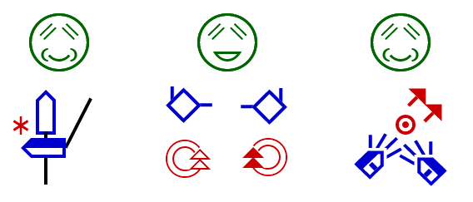
Signwriting Humor Cards

Slide 31
Wishing Cards

Slide 32
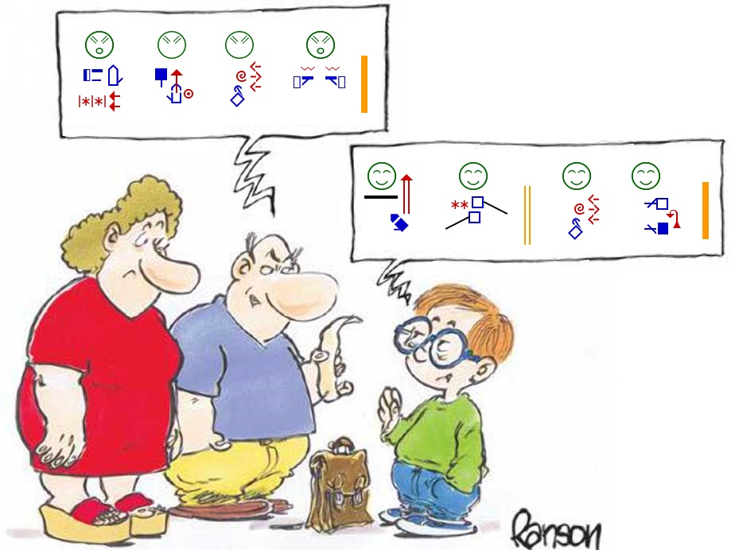

Slide 33
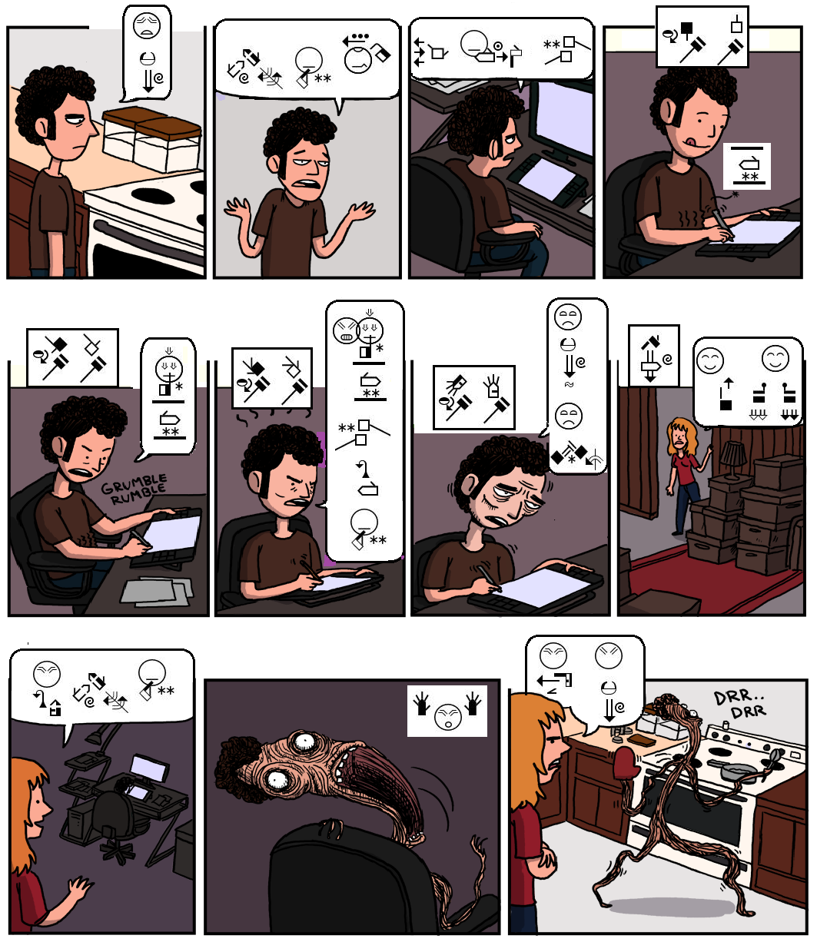

Slide 34
Christian Cards

Slide 35
Christian Cards

Slide 36
Muslim Cards

Slide 37
Jewish Cards

Slide 38
International Days

Slide 39
Sensitization Cards

Slide 40
Fun Cards

Slide 41
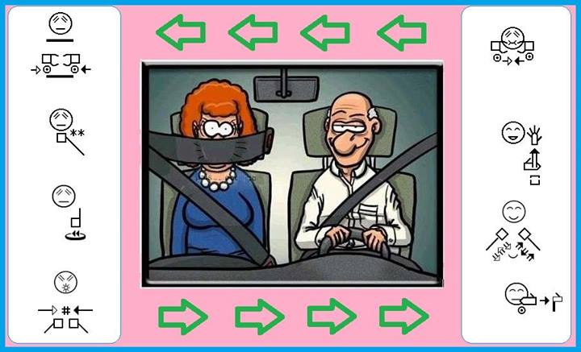
Fun Cards

Slide 42
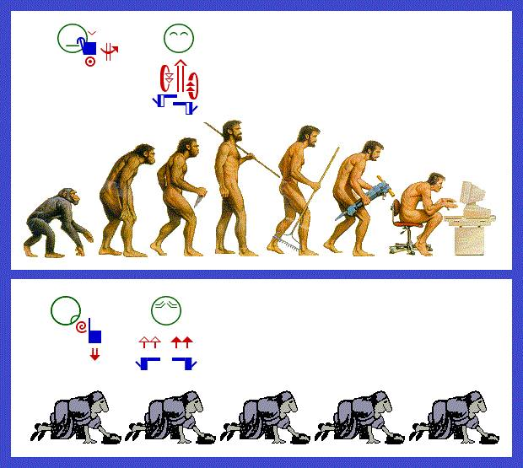
Fun Cards

Slide 43
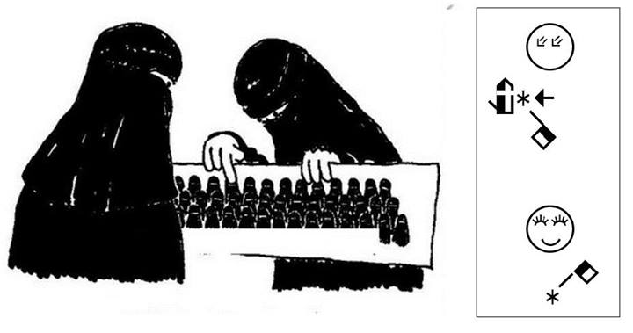
Fun Cards

Slide 44
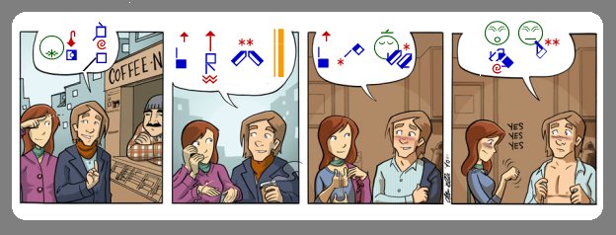
Fun Cards

Slide 45
Quotation

Slide 46
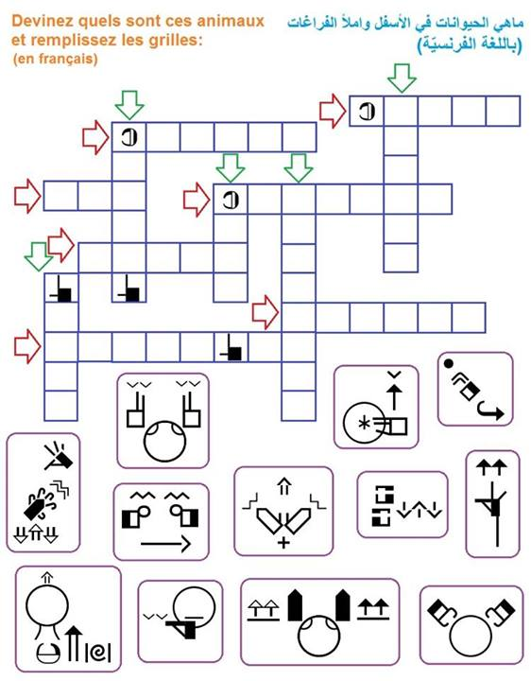
Game

Slide 47
Join Us On facebook https://www.facebook.com/forumtunisiendesingwriting

Slide 48
Bye-bye

