Slide 1
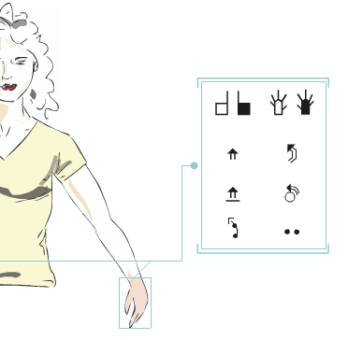
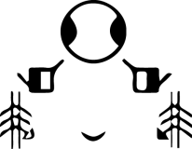
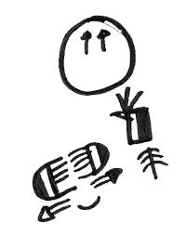
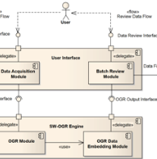
Implementation into the SWORD project of observations arising from the process of users‘ appropriating and adapting SignWriting
Claudia S. Bianchini¹, Fabrizio Borgia^{2,3}
¹ Université de Poitiers - FoReLL
² Université Toulouse III - Paul Sabatier
³ Sapienza Università di Roma

Slide 3
We are ...
 | ■ Fabrizio Borgia, PhD (Informatics) candidate _2010: MS thesis on the development of a SW editor (SWift) _2011-today: PhD dissertation for the digital implementation of SW (SWift, OGR…) in the framework of the project “SWord”
■ dr Claudia S. Bianchini, associate professor of SL linguistics _2007-2012: PhD dissertation with Elena Pizzuto’s supervision; the metalinguistic considerations of deaf people using and appropriating SW become the main focus of her research _2013-today: tenured at Poitiers as a LS scholar, continues her research on the systems for the graphical representation of SLs, while also providing linguistic advice in the SWord project
 | _dr Maria de Marsico, assistant professor of Informatics _2009: partecipates in the project “VISEL” (together with E. Pizzuto) as head of the research team “Pictorial Computing Lab” (in charge, among other tasks, of the IT part of the project) _2010: suggests a SW topic for Fabrizio Borgia’s experimental thesis _2011-today: is major professor of Fabrizio’s PhD course and supervises the team of researchers working for the SWord project

Slide 4
Italy and SignWriting
The ’90s: Elena wonders about the feasibility . of understanding the LIS without a suitable system for its representation… the forerunners of the team probe various systems, e.g. the Stokoe’s notation and SignFont
2000: Valerie and Elena talk for the first time, by phone
Paolo and Barbara learn SW by themselves
Thereafter, they teach it to other deafs, and to hearing people too
A first paper on SW (Pizzuto, Rossini, Sutton)
The team "Written‑LIS laboratory” (LLISS) is born in Rome, at the “SignLanguage Lab” of the ISTC‑CNR
6 deaf, 3 hearing people: SL is the sole working language
2009: in the framework of the VISEL project, researchers of linguistics and informatics begin to collaborate, posing the bases for establishing the SWord project

Slide 5
What is the SWord project
SWord: SignWriting Oriented Resources for Deafs
Established thru the collaboration of linguistics and informatics researchers
R&D of digital systems, aimed at making SW more accessible
To deaf users, eager of writing in their own language
To researchers, resolved to transcribe SLs
Based on the Elena Antinoro Pizzuto’s idea of “deaf-centering”
I.e., making research with, not on the deaf people

Slide 6
The SignWriting Symposium 2014
During this webinar, you’ll see 3 presentations of our project:
[Research/01] “Implementation into the SWord project of observations arising from the process of users' appropriating and adapting SignWriting”
[Software/04] “SWift, a user-centered digital editor for SignWriting within SWord project”
[Software/33] “A proposal for the recognition of handwritten SignWriting for SWord project”

Slide 8
Examining SignWriting
Two main approaches for analysis:
“In vitro”
Systematic analysis of the intrinsic characteristics of SW, regardless of it actual use
“In vivo”
Observation and analysis of SW utilization by LLISS people
Observation and analysis of questions posted in the SW-List

Slide 9
LLISS, SW-List & recurrent problems in SW
A rapid scan of the SW-List suffices to realize that, notwithstanding its relative simplicity, SW presents some consistent trouble
A similar finding arises from observing LLISS activities
Why do recurrent problems exist? how may it be possible to solve them?

Slide 10
SignWriting and its consistent troubles
New users often learn SW by themselves, relying on:
The SW manual (theory)
SignPuddle (practice)
The amount of glyphs present in ISWA has increased over time
Notwhitstanding the efforts to keep the whole system coherent, the “history” of SW evolution has left its mark with every succeeding version of SS/IMWA/ISWA
Nor the manual nor SignPuddle explicit all the rules for glyph transformation
based on ISWA

Slide 11
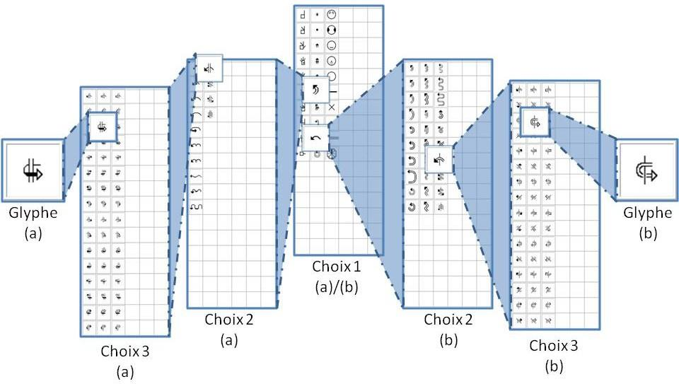
E.g.: glyph organization in SignPuddle
In SignPuddle, selecting two very similar glyphs follows very different paths
The rules for glyph transformation are not explicit

Slide 12
E.g.: glyph organization in ISWA and in the manual
In ISWA2008, movements are arranged by trajectories, not by the body part involved
The graphical similarities among glyphs, relative to similar body parts, are lost
The manual mirrors such an arrangement

Slide 13
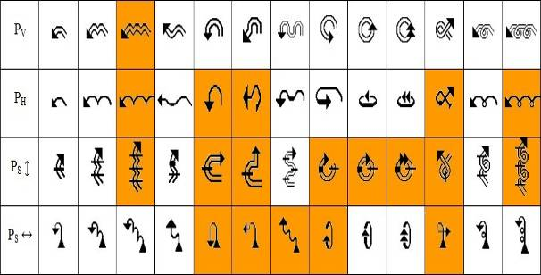
E.g.: glyph organization in ISWA2008
Furthermore, there are many “holes” in the classification
E.g.: movements possible only on one single plane, and not on others

Slide 14
Our proposal: a reclassification
Re-arranging SW to explicit all the functional and graphic rules securing the glyph production
Removing irregularities (“exceptions”)
Still, without messing with Sutton & Co’s foundations

Slide 15
Advantages of the reclassification
Thanks to the reclassification,
All the rules for using each glyph are 100% explicit (clarity) and without exceptions (coherence)
Following these rules, the set of glyphs may be completed maintaining a systemic coherence
The parameters of each trait may be investigated, even when glyphs do not belong to the same category
Great usefulness in linguistics

Slide 16
Reasons from “in vivo” observations on why new glyphs are added
At LLISS, deaf people prefer hand-writing
Failing to find specific glyphs, they invent new ones (“ad hoc” glyphs)
That’s a true process of adaptation and appropriation of SW
But composition rules are quite strict
Almost the same as those pointed out in the reclassification

Slide 17
Defining the ad hoc glyphs
An ad hoc glyph should:
Fill a (alleged) void in SW
Sprout from the union or meaning modification of existent glyphs
Be coherent with the system
Be easy to understand
Aspire to be duly included in the official SW
Notes:
Definizione dei glifi non convenzionali
Definiremo come non convenzionali i glifi:
non presenti nel set originale di Sutton (ISWA, Internationa Sign Writing Alphabet) o presenti ma con un’altra funzione
che rimpiazzano un glifo inesistente o supposto tale dall’utilizzatore
coerenti con il sistema SW perché:
frutto dell’unione di vari glifi convenzionali
frutto della modificazione di uno o più glifi convenzionali
totalemente nuovi ma rispettanti le regole del SW
facilmente leggibili da parte di altri esperti di SW
che possono aspirare a rientrare in una nuova versione dell’ISWA

Slide 18
Utilizing the ad hoc glyphs
During script production, deaf experts have contrasting attitudes toward ad hoc glyphs
Creativity and productivity vs. rigors and command
BUT:
Everybody uses ad hoc glyphs, often without realizing it
During script scanning, readers are not even aware of the presence of an ad hoc glyph
Truly ad hoc glyphs are well integrated in the system and therefore they do not appear as aliens
Notes:
La scrittura al computer: SignMaker
I glifi non convenzionali rallentano l’inserzione dei segni in SignMaker
La scrittura informatizzata permette di riconoscere subito un glifo non convenzionale
Durante la ricerca delle componenti dei segni, i glifi non convenzionali, frutto dell’unione grafica di più glifi, pone problemi:
sono (è evidente!) presi esattamente per quel che sono: un’altro glifo!

Slide 19
Conclusions
Deaf people at LLISS acquired SW fast and easily
Some recurrent problems may be solved merely expressing all the rules
This requires a thorough reclassification of the whole system, yet without straining its intrinsic nature
Such a systemic reclassification has been carried out and implemented “on the drawing board”, but every user does it in his own head;
thus, the research “just” revealed a concealed phenomenon

Slide 20
Conclusions
SW is still a “young” system
It has not settled yet
SW has been not “imposed on” but “adopted by” the deaf
That’s the reason it is the only system suited for writing SLs
Observing the way of using it by the deaf people is of major interest for linguistics researchers, whether studying SLs or analyzing graphical systems

Slide 21
Acknowledgments
To the graduating students of the Master in Informatics . Informatics at the University of Rome I “Sapienza”, who contributed in implementing parts of OGR:
D._Della_Valle,_L._Franciosi, _L._Fochetti,_N._Pllaha,_M._Rotiroti
To the members of the “Sign Language Laboratory” (now “Sign Languages and Deaf Studies”) of the ISTC-CNR of Rome, who originated data and metalinguistic speculations exploited by C.S._Bianchini for her PhD dissertation, which is the core of this presentation:
E._Antinoro_Pizzuto,_A._Di_Renzo,_G._Gianfreda,_L._Lamano,_T._Lucioli, B._Pennacchi,_G._Petitta,_P._Rossini,_V._Volterra
To the professors and researchers, who closely followed the progress of our work:
D._Boutet,_M._Castelli,_C._Cuxac,_P._Dalle,_A._Perri

Slide 22
Abstract (1/2)
Since the early years of the 2000s, SW has been used as a transcription and writing system for Italian Sign Language (LIS) by the "Written-LIS laboratory” (LLISS) at the ISTC‑CNR in Rome. Between 2007 and 2012 during the preparation of her doctoral thesis, Bianchini [1] observed the modalities of using SW at LLISS and analyzed the ways by which its deaf and hearing members made the system their own.
It is worth mentioning that the LLISS people were self‑taught in SW, on the basis of the 1995 manual and of the 2004 version of SignPuddle. Despite a very good knowledge of SW, we noted recurring problems in its use, and tried to understand the reasons. We thus realized that many difficulties arose because of the lack of strict coherence in the organization of SW (see Note 1) that was evident both in the manual and in the 2006 SignPuddle
server in use in the . lab. One example is the . movements of the hands . in which: (1) all changes in a BaseSymbol do not describe the same trajectory; and (2) it is not possible to realize the same trajectories on every level (Figure 1). Therefore, we decided to carry out a complete reorganization of SW while totally respecting the work of Sutton and her team (I.e., no “original” glyph has been deleted), but suggesting additions so as to increase the coherence of the system (see Fig.1) [2]. This idea originated observing
Figure 1 - White boxes: the possible trajectories within the official ISWA2008, by planes; Orange boxes: the trajectories that were added improve the system coherence.

Slide 23
Abstract (2/2)
the written productions of LLISS people, where many glyphs were created "ad hoc" to represent movements, configurations, facial expressions and other signing elements not already provided in the different versions of SW.
This reclassification required a new numbering system for the glyphs, which also involves the advantage, for the linguists, to easily extract the different glyph features (e.g., a query may extract all, and only, the movement from right to left of the right hand in the horizontal plane).
This work, however, was not an end in itself: in fact, all the deaf people we worked with prefer to hand‑write SW, considering the use of SignPuddle too slow; therefore, as part of the project SWord (SW Oriented Resources for the Deaf) implemented by the Informatics Dept of University of Rome I “Sapienza”, and in particular of the Borgia’s
doctoral Dissertation, a . new software was created, . which allows to quickly . digitally‑write SW. This software, called SWift (SW improved fast transcriber) [3], is based on said reclassification and will be presented in detail in the paper by Bianchini, Borgia & De Marsico.
_____________________________________
[1] C.S. Bianchini. 2012. Analyse métalinguistique de l'émergence d'un système d'écriture des Langues des Signes: SignWriting et son application à la Langue des Signes Italienne (LIS). Ph.D. thesis, Uni. Paris 8 – Univ. Studi Perugia.
[2] C.S. Bianchini, F. Borgia. 2012. Writing Sign Languages: analysis of the evolution of the SignWriting system from 1995 to 2010, and proposals for future developments. Proc. Int. Jubilee Congress of the Technical University of Varna, 6: 118‑123.
[3] C.S. Bianchini, F. Borgia, P. Bottoni, M. De Marsico. 2012. SWift: a SignWriting improved fast transcriber. in Proceedings of AVI2012 (Capri, 21-25 May 2012).
_____________________________________
Note 1: Mostly due to the fact that SW is a system in constant evolution and, as such, is the result of “sedimentation” of several successive layers (see for more details Bianchini & Borgia, 2012).

Slide 24
Introducing SWord project
Claudia S. Bianchini¹, Fabrizio Borgia^{2,3}, Maria de Marsico³
¹ Université de Poitiers - FoReLL
² Université Toulouse III - Paul Sabatier
³ Sapienza Università di Roma

