Slide 1
Literacy in a Trilingual Context using Sign Writing: the Paraguayan Experience
By Mirta E. Barreto
July 2014

Slide 2
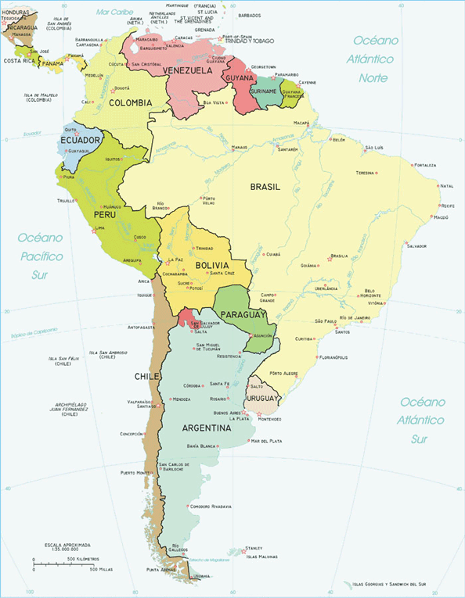
Paraguay: a Bilingual country
Paraguayan Sign Language (LSPy)
39.3% (65,3% rural area ) Guarani monolingual
49% (24,5% rural area) type of bilingual
6.4% Spanish

Slide 3
Paraguayan Deaf population
(a) the rural and isolated Deaf
(b) the older generation of Deaf
c) the semi-literate Deaf
(d), and the well connected, urban Deaf

Slide 4
What about them?
There are deaf people living in the rural areas isolated from Deaf schools who do not have the opportunity to learn Paraguayan Sign Language (LSPy).
Those deaf people use home sign or gestures, and are illiterate in LSPy, Spanish and Guaraní.
Another fact is that in rural areas, they do not have DVD players, or even access to electricity connection.

Slide 5
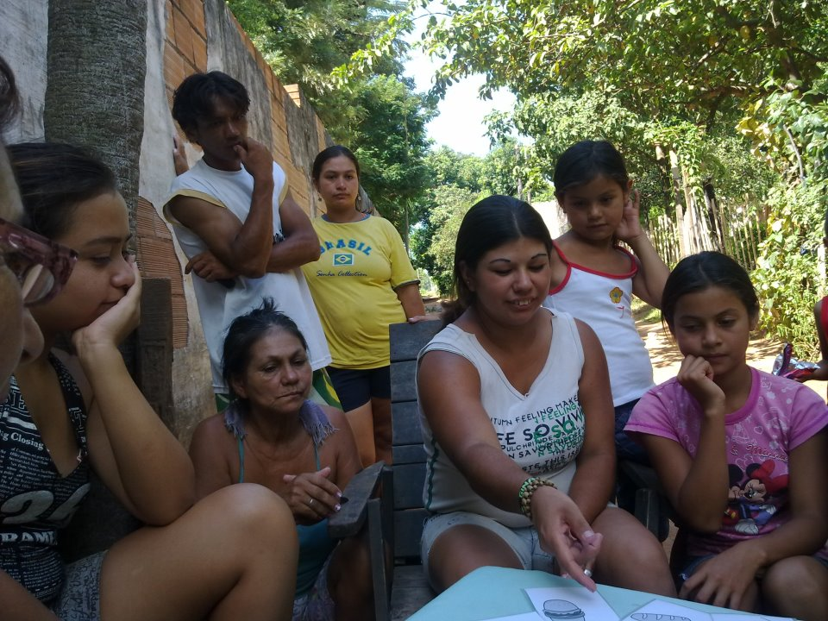
Deaf families

Slide 6
Homesign only

Slide 7
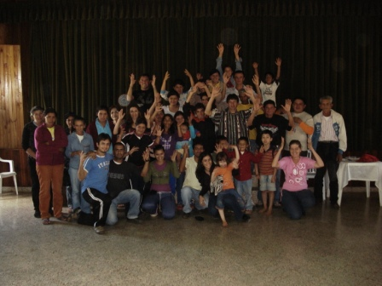
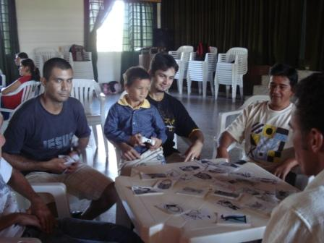
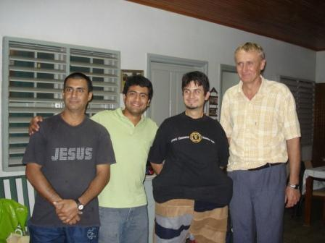
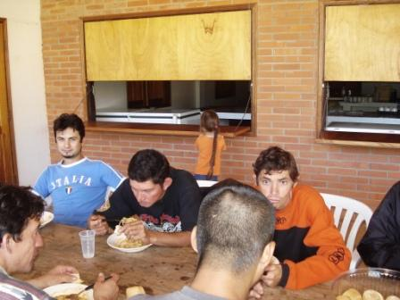
2010 Teaching LSPY in Friesland

Slide 8
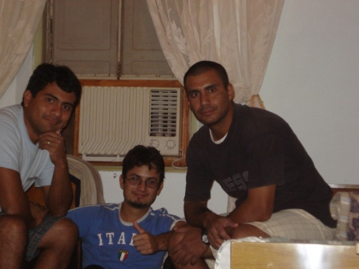
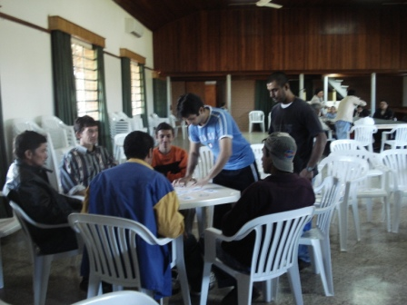
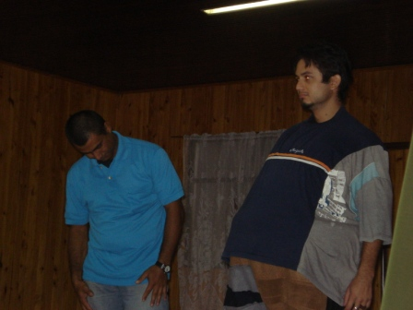
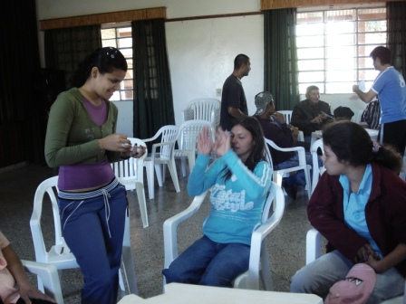
2010 Teaching LSPY in Friesland

Slide 9
What is it? Sign Writing?
Beauty Beyond Words (2008)
SIL course (2009)
SIL course (2010)

Slide 10
What is SignWriting?
SignWriting is a writing system which uses visual symbols to represent the handshapes, movements, and facial expressions of signed languages. It is an "alphabet" - a list of symbols used to write any signed language in the world.
http://www.signbank.org/signpuddle/index.html#signpuddle2.0

Slide 11
SignWriting Experience
From “dificil” to “fácil”
Deaf community participation
Showing how to use and the benefits
Let´s try it.

Slide 12
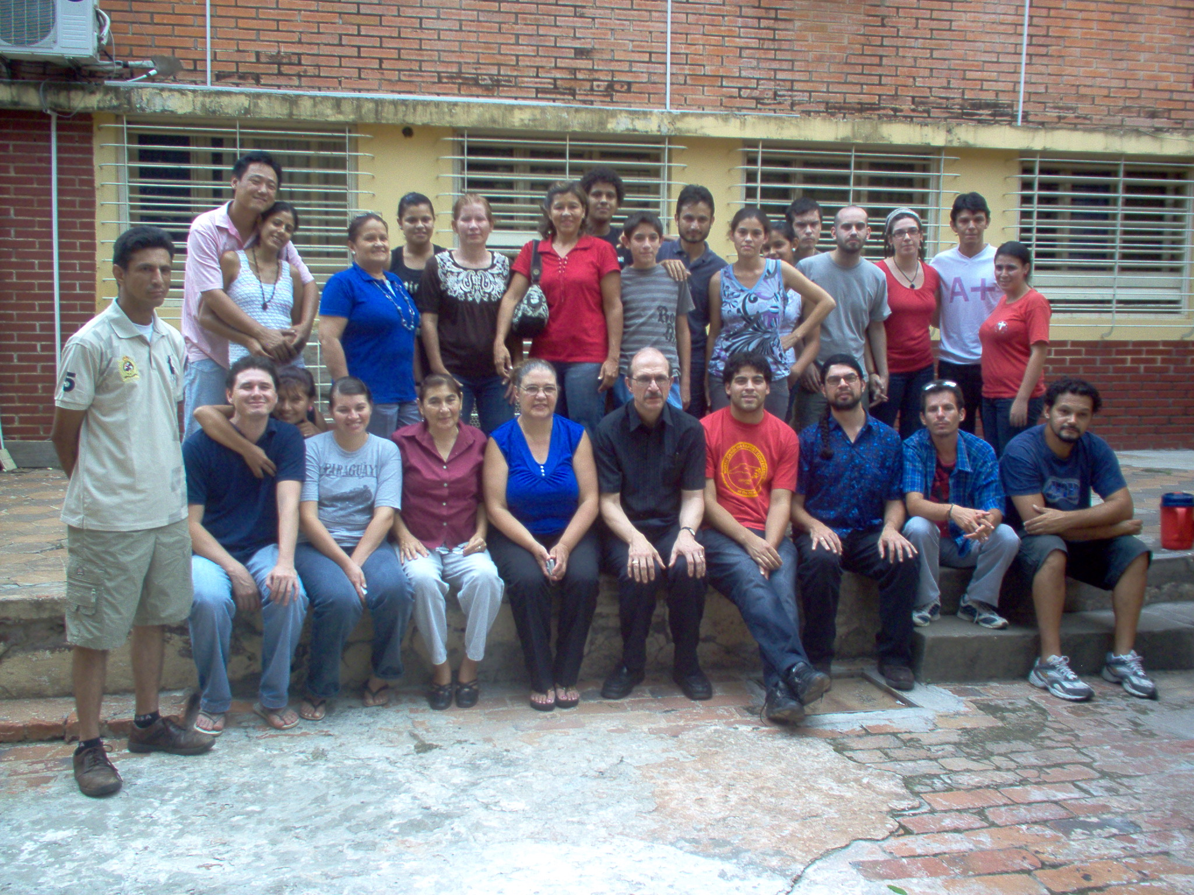
2011 Translation and Sign Writing Worshop

Slide 13
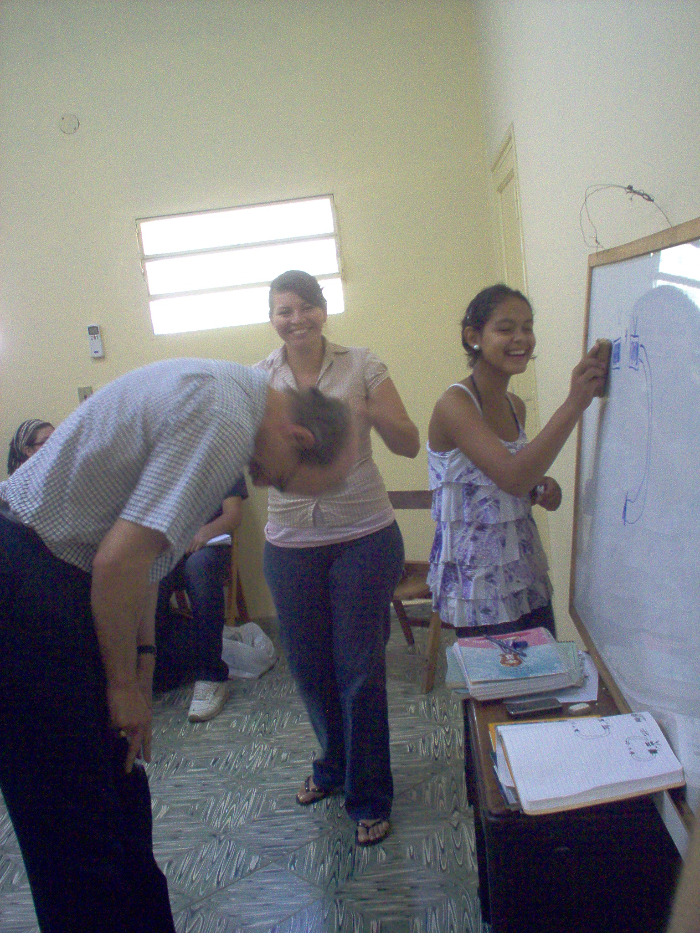
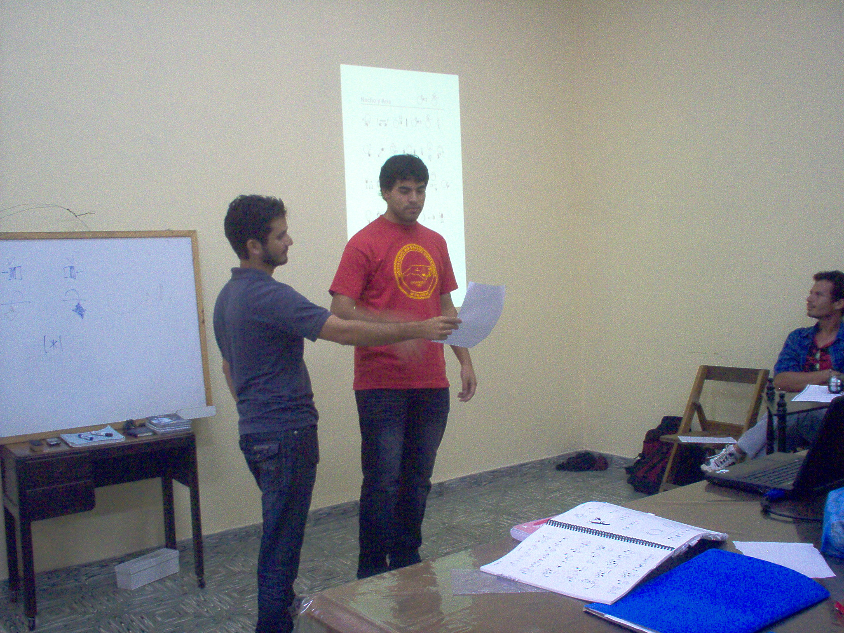

Slide 14
Deaf Literacy

Slide 15
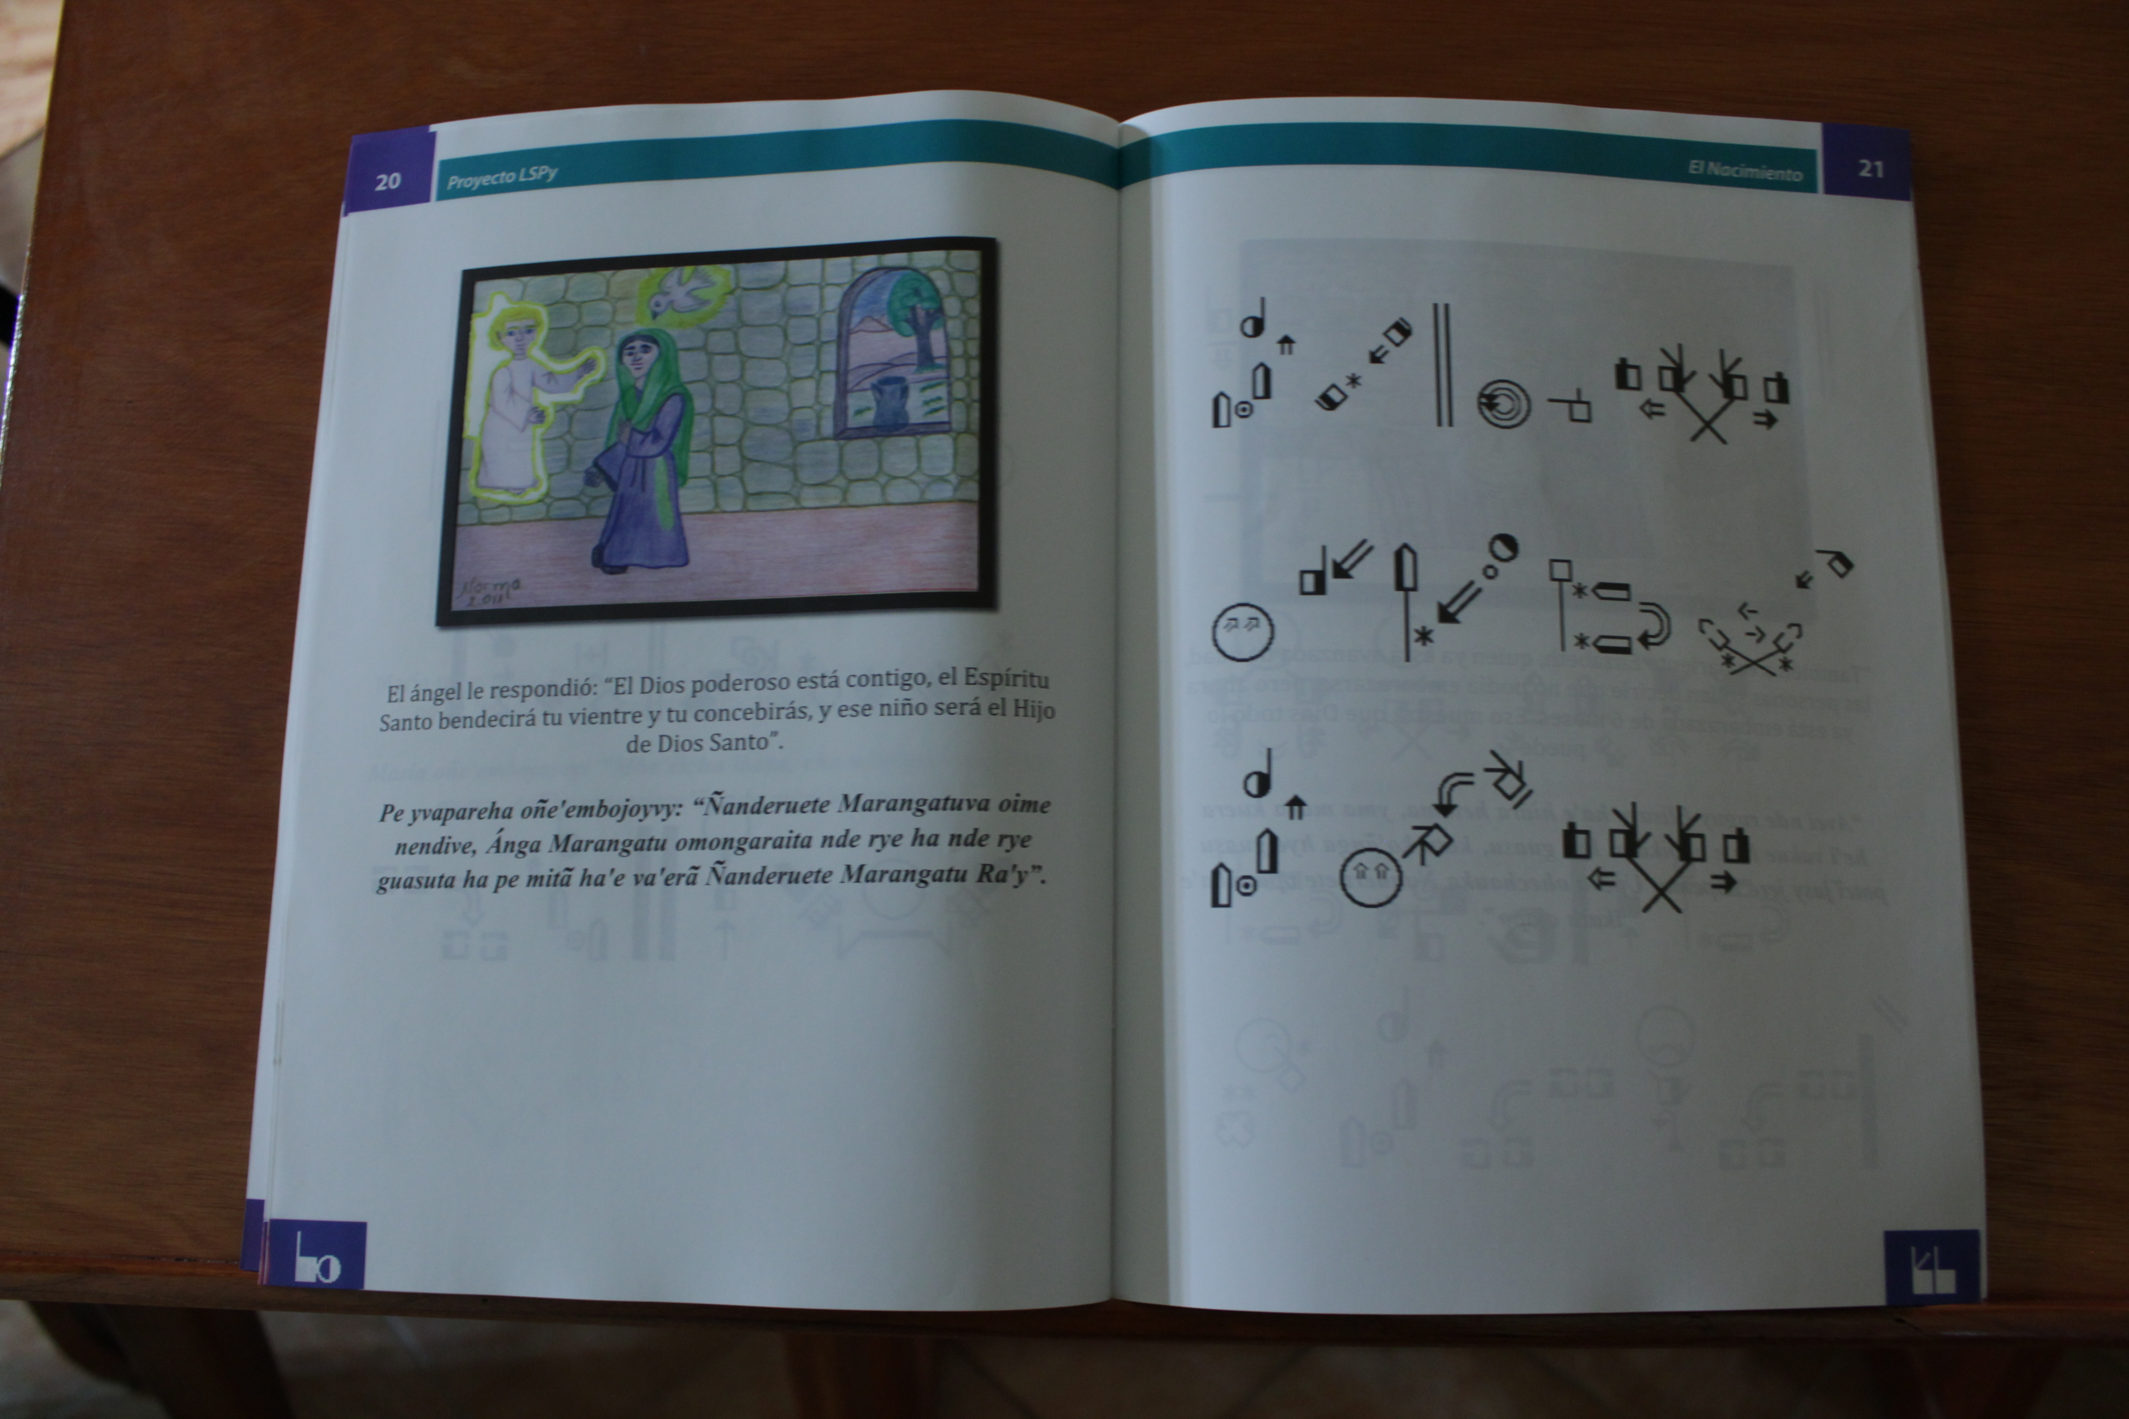
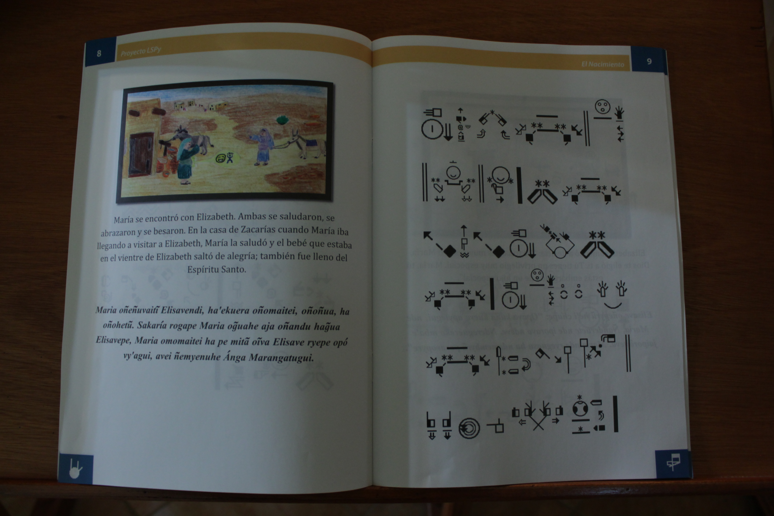
Bible stories in Spanish, Guarani, and LSPy

Slide 16
The goals:
Increase the literacy rate in LSPy, Spanish, and Guaraní.
Increase mutual understanding between the parents and their deaf child.
Help indigenous deaf people to learn LSPy (Paitabytera, Ache, etc.)

