Slide 1
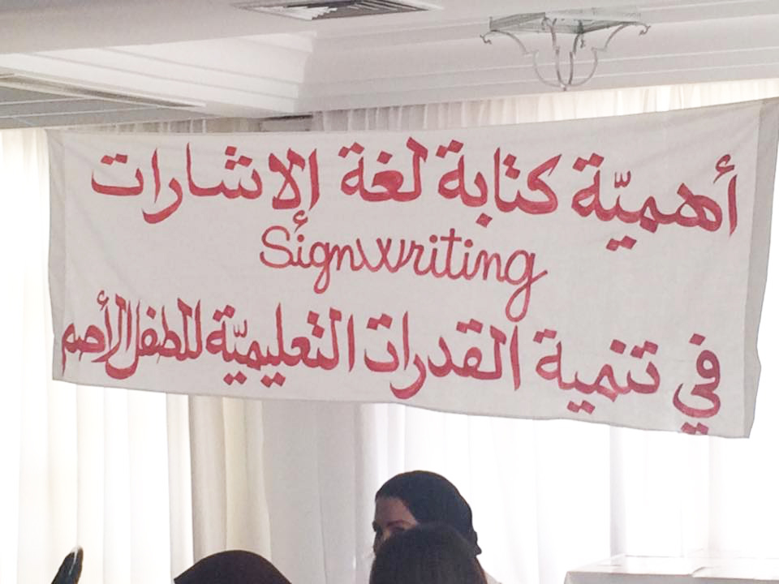
SignWriting in Tunisian Deaf Education May 4, 2016

Slide 2
Invitation to the SignWriting Event May 4, 2016, Tunisia

Slide 3
Wafa Laajili, teacher of Deaf children, presented her materials & experiences

Slide 4
Educators learned about SignWriting…

Slide 5
The presentation told of the history…

Slide 6
…and showed videos of students...

Slide 7
The materials are beautiful and so many! Here is a map of Tunisia…

Slide 19
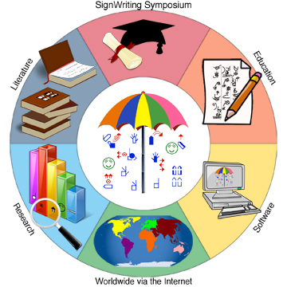
SignWriting in Tunisia SignWriting Symposium Online 2014, 2015 & 2016
Presentation 15:
“The Importance of SignWriting in Deaf Education in Tunisia”
http://www.signwriting.org/symposium/presentation0015.html
Presentation 23:
“TuniSigner: A Virtual Avatar to Interpret SignWriting Notations”
http://www.signwriting.org/symposium/presentation0023.html
Presentation 52:
MemoSign Game: A learning Game for Deaf Learners, Tunisia
http://www.signwriting.org/symposium/presentation0052.html
Presentation 56:
“SignWriting in Tunisian Deaf Education”
http://www.signwriting.org/symposium/presentation0056.html

