Slide 1
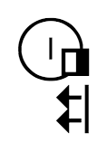
SignWriting in Unicode and Rich Text Considerations
Presented at the SignWriting Symposium on July 20th, 2016
by Stephen E Slevinski Jr
in association with the Center for Sutton Movement Writing
http://www.signwriting.org/symposium/presentation0061.html

Slide 2
The Big Umbrella of the Center for Sutton Movement Writing
All sign languages supported right now.
Various hand writing styles.
4+ years of stable and free standards.
Many implementations from separate groups.
Formal SignWriting (FSW) standard

Slide 3
Formal SignWriting
FSW is a formal language and a script encoding
AS18711S20500M514x517S18711490x483S20500486x506
Time
Space
AS18711S20500
M514x517S18711490x483S20500486x506
A
S18711
S20500
M514x517
S18711490x483
S20500486x506
M
514x517
S18711
490x483
S20500
486x506
Sequence
Marker
(514,517)
(490,483)
(486,506)
Symbol
Middle Lane
SignBox
Max
Coord
Spatial
Symbol

Slide 4
Real World Impact
Moving forward with sign language projects under Wikimedia.
WikiConference USA
October 2016 in San Diego
https://meta.wikimedia.org/wiki/WikiConference_USA
Formal SignWriting
Adoption
Unicode
Considerations
SignWriting Encyclopedia Projects: Wikipedias in
American Sign Language and Tunisian Sign Language
http://www.signwriting.org/symposium/presentation0064.html

Slide 5
SignWriting in Unicode Next
UTC # 148 (August 3-5, 2016)
Discuss accomplishments
Share insights
Create action items
SignWriting Design, With Three
Examples and Their Representation
http://www.unicode.org/L2/L2015/15219-signwriting-design.pdf

Slide 6
SignWriting Design, With Three
Examples and Their Representation
M536x518S2ff00482x483S10000521x457

Slide 7
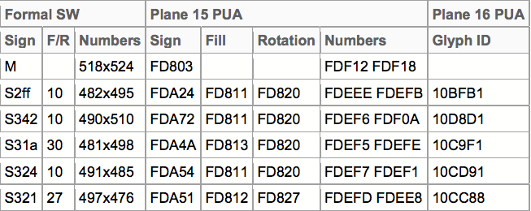
SignWriting Design, With Three
Examples and Their Representation
M518x524S2ff10482x495S34210490x510S31a30489x498S32410491x485S32127497x476

Slide 8
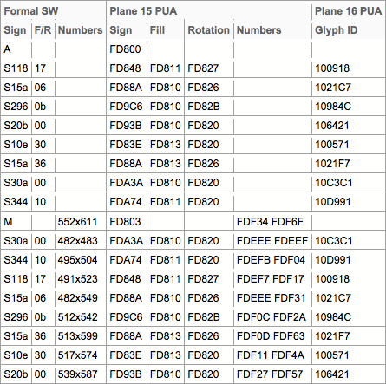
SignWriting Design, With Three
Examples and Their Representation
AS11817S15a06S2960bS20b00S10e30S15a36S30a00S34410M552x611S30a00482x483S34410495x504S11817491x523S15a06482x549S2960b512x542S15a36513x599S10e30517x574S20b00539x587-CZx

Slide 9
Discussion Ideas
Script Encoding Model
PUA Plane 15 (1,179 characters)
2-Dimensional Layout with Graphite and Cartesian coordinates
SignWriting has a prototype font that uses Cartesian coordinates to control the 2-dimensional layout with Graphite and PUA Plane 15 characters. If you have any experience with 2-dimensional layout using Cartesian coordinates, let’s discuss the possibilities.
Symbol Encoding Model
PUA Plane 16 (37,811 characters)
Entire Plane for the International SignWriting Alphabet 2010
The ISWA 2010 uses 37,811 glyphs. Each glyph has a unique code point on Private Use Area Plane 16. These code points are used in the 16-bit font files. Rather than use plane 16, it would be nice to use Plane 4.
both designs are productive and plane 16 is used with fonts

Slide 10
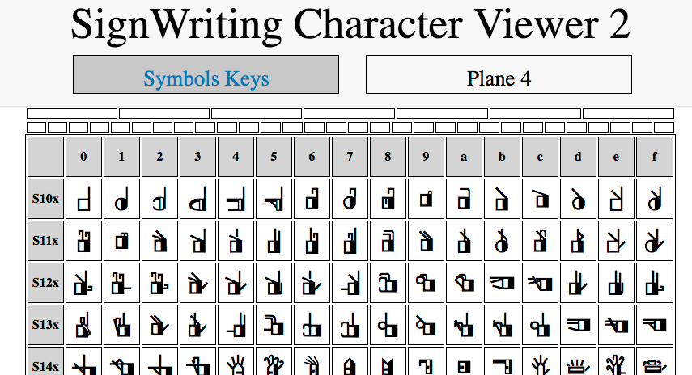
CSMW Proposal for Unicode 10
and 2016 Font Development
Symbol Encoding Model
Plane 4 (37,811 characters)
No Private Use Area
No Ligatures
Temporary Characters
used with 2 TrueType Fonts
16-bit glyphs set
created by Valerie Sutton
652 Palettes of 6 by 16 Grid
SVG and CSS
for presentation
Dynamic Pages: single file 114 KB
http://signbank.org/SignWriting_Character_Viewer_2.html

Slide 11
CSMW Proposal for Unicode 10
with Vertical Layout and Lanes
HTML and CSS Hardcoded
http://codepen.io/Slevinski/pen/zqGNqz
JavaScript and CSS Dynamic
http://codepen.io/Slevinski/pen/MywOej
Visit either link, then change page size or zoom.
The signs will reflow into different columns.

Slide 12
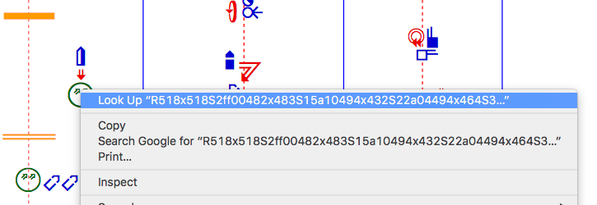
CSMW Proposal for Unicode 10
Individual Sign Copy and Paste
Double-Click or Triple-Click an individual signs to select.
Use the Alternate-Click on the same sign for a menu to copy.
An individual sign may or may not appear selected.

Slide 13
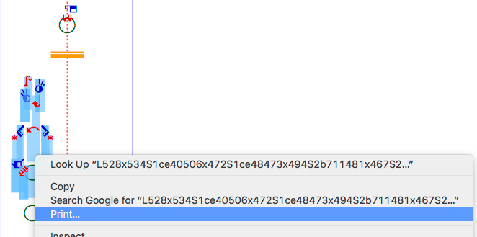
CSMW Proposal for Unicode 10
Multiple Sign Copy and Paste
Using the mouse, click and drag to select several signs.
The FSW will be selected, possibly with plane 4 or 16 characters.

Slide 14
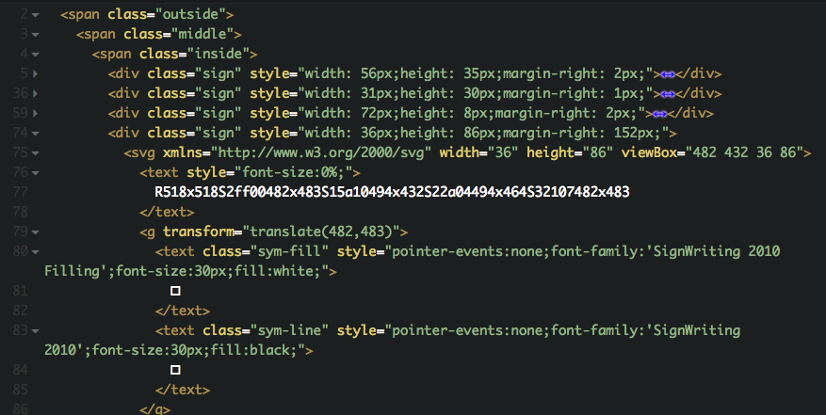
CSMW Proposal for Unicode 10
with Vertical Layout and Lanes
HTML
FSW
source
coordinates
Unicode
Plane 4 or 16
for S2ff00
http://codepen.io/Slevinski/pen/zqGNqz

Slide 15
Formal SignWriting and Fonts
Render FSW with style, zoom, and reflow
https://slevinski.github.io/SignWriting_Character_Viewer/
Version 1: Private Use Area Plane 16
SignWriting 2010 Fonts
Version 2: Proposed Unicode 10 Plane 4
Sutton SignWriting Fonts
Sutton SignWriting rendered from Formal SignWriting
with 2 KB each of HTML, CSS and JS
http://codepen.io/Slevinski/full/XKRPzm/

Slide 16
Plain Text
Unicode Standard: Chapter 2
Plain text must contain enough information to permit the text to be rendered legibly, and nothing more.
Plain text is a pure sequence of character codes;
Formal SignWriting is Plain Text.

Slide 17
Rich Text
Unicode Standard: Chapter 2
Rich Text is any text representation consisting of plain text plus added information such as a language identifier, font size, color, hypertext links, and so on.
Rich text carries complex formatting information as well as text context.
Given that rich text equals plain text plus added information, the extra information in rich text can always be stripped away to reveal the “pure” text underneath.

Slide 18
After Formal SignWriting
Styled SignWriting Text
Size and color within a sign.
Settings for all symbols
Settings for specific symbols
Styling String
-D_blue_
Styling String
--D03_blue_

Slide 19
Defining Colors
CSS color names or hex values
CSS Color Names
red
green
blue
Hex Values (3 or 6 long)
FF0
FF0000

Slide 20
SignWriting Styling String
using color and size within a sign
- Adjusting all symbols
C - Colorize
P - Padding
G - Background
D - Detail colors
Z - Zoom level
-- Adjusting specific symbols
D - Detail colors
Z - Zoom level

Slide 21
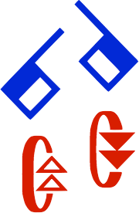
Colorize - All Symbols
Styling String
-C

Slide 22
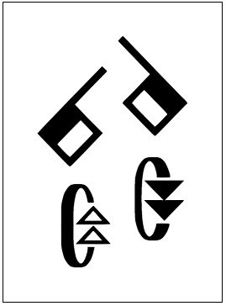
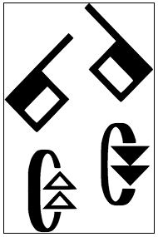
Padding - All Symbols
Signs default with a tight bounding-box.
Styling String
-P10
Padding value must be a 2 digit string, from 01 to 99.

Slide 23
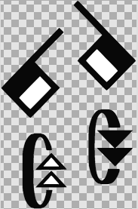
Background - All Symbols
Signs default with a transparent background
Styling String
-G_lightblue_

Slide 24
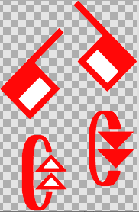
Detail Colors - All Symbols
Signs default with a
black line and white fill
Styling String
-D_red_

Slide 25
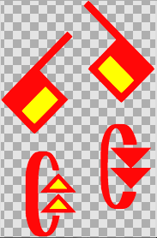
Detail Colors - All Symbols
Signs default with a
black line and white fill
Styling String
-D_red,yellow_

Slide 26
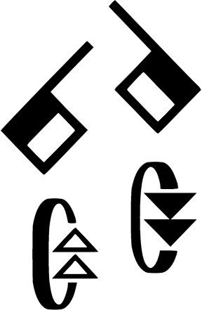
Zoom Level - All Symbols
Signs default with a
size of 1
Styling String
-Z6.4
Zoom level can be any integer or decimal value.

Slide 27
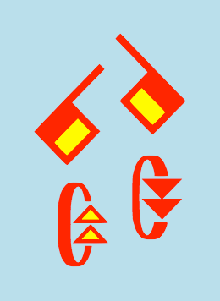
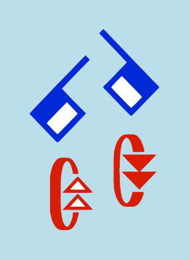
Combinations - All Symbols
Styling String
-P10G_lightblue_D_red,yellow_Z4
Styling String
-CP10G_lightblue_Z4
The order of the styling options is important.

Slide 28
Detail Colors - Specific Symbols
Styling String
--D01_red,yellow_
Styling String
--D02_red,transparent_
Styling String
--D03_red_
Specific symbols are identified using a 2 digit string, from 01 to 99.

Slide 29
Zoom Level - Specific Symbols
Styling String
--Z01,2
Styling String
--Z02,2,480x490
Styling String
--Z03,2,510x500
The zoom level for specific symbols allows for an optional adjustment coordinate, with 500x500 meaning no adjustment.

Slide 30
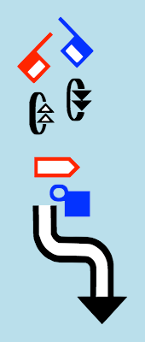
Complex Styling
Styling String
-P10G_lightblue_Z2-D01_red_D02_blue_D06_red_D07_blue_Z05,2
The order of the styling options is important.

Slide 31
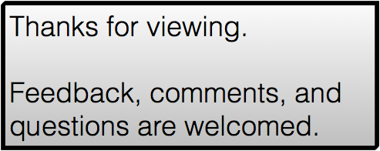
SignWriting in Unicode and Rich Text Considerations
by Stephen E Slevinski Jr
slevinski@signwriting.org
http://signpuddle.com
http://www.signwriting.org/symposium/presentation0061.html

