Slide 1
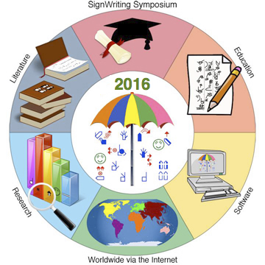
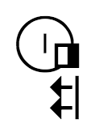
Moving Forward with
Sign Language Projects in
Formal SignWriting (FSW)
Presented at the SignWriting Symposium on July 18th, 2016
Also for WikiConference USA
San Diego, October 7–10, 2016
by Stephen E Slevinski Jr
in association with the Center for Sutton Movement Writing
http://www.signwriting.org/symposium/presentation0055.html

Slide 2
The Big Umbrella of the Center for Sutton Movement Writing
All sign languages supported right now.
Various hand writing styles.
4+ years of stable and free standards.
Many implementations from separate groups.
Formal SignWriting (FSW) standard

Slide 3
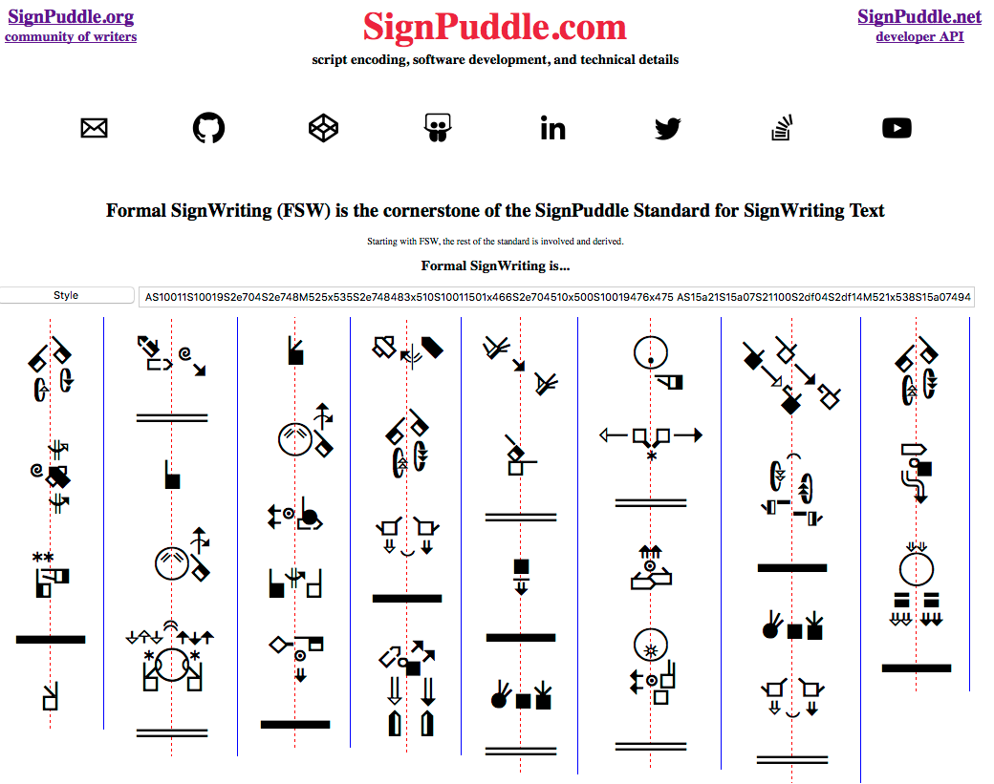

Slide 4
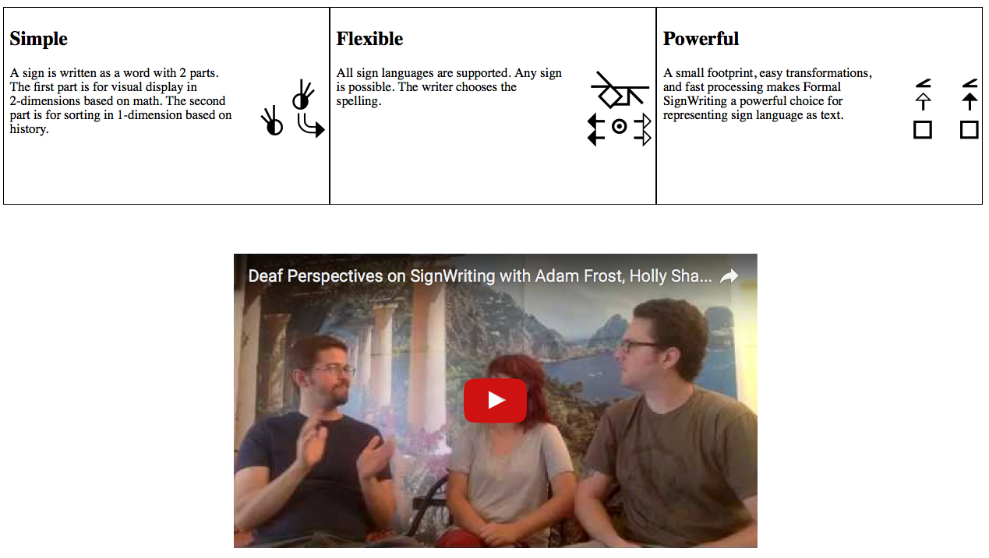
Formal SignWriting is…
https://www.youtube.com/watch?v=Gg5oKIpArmE

Slide 5
Formal SignWriting
FSW is a formal language based on a script encoding
AS18711S20500M514x517S18711490x483S20500486x506
Time
Space
AS18711S20500
M514x517S18711490x483S20500486x506
A
S18711
S20500
M514x517
S18711490x483
S20500486x506
M
514x517
S18711
490x483
S20500
486x506
Sequence
Marker
(514,517)
(490,483)
(486,506)
Symbol
Middle Lane
SignBox
Max
Coord
Spatial
Symbol

Slide 6
Formal Conventions
Valerie Sutton created a collection of visually iconic symbols that exists in a layered hierarchy
The exact form of each symbol is structured, standardized, and highly featural.
This formal writing is called Block Printing. It is used in education, publishing, and is the basis of the computerized model.
By contrast, handwriting can be used informally with fewer features and less detail. However, this can create notes that are sketchy compared to the clarity of formal Block Printing.

Slide 7
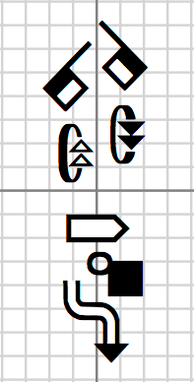
Freeform Construction
SignWriting is an unconventional script because it is not written sequentially. Rather than a string of letters, each sign is written as a 2-dimensional cluster of symbols.
The freeform construction of the signs does not impose any rules or restrictions on the writer. Because of this, any sign of any sign language can be written without limitation.

Slide 8
Formal Order
The 11th Century Song Chinese developed the movable type printing press. Each piece of type contained a single character mostly equivalent to a word. Great block houses developed with hundreds of thousand of type pieces each. However, the Chinese logographic system is open-ended. New words require new type. Each house created their own specialized logograms. Organizing the numerous type pieces became a problem. It was easy to understand how to organize the basic type, but new logograms didn’t have a definite place within the established order. The practice developed to attach slips of paper to unusual logograms with a sequential list of more standard writing. This way, each piece of type was easy to organize and it was possible to learn the ordering for the new logograms.

Slide 9
Formal Order
SignWriting has developed a similar mechanism. Since we can not use a 2-dimensional sign definition for sorting, we create a separate list of order symbols. The ordering of the symbols is subjective and based on a particular theory of sorting. The most productive is Valerie Sutton’s theory of the SignSpelling Sequence.

Slide 10
Formal Language
According to Wikipedia, "In mathematics, computer science, and linguistics, a formal language is a set of strings of symbols that may be constrained by rules that are specific to it."
Sign as Word
Mathematical ASCII name
Optional time for sorting
Mandatory space for visual
https://tools.ietf.org/html/draft-slevinski-signwriting-text#section-2

Slide 11
Formal SignWriting and Fonts
Render FSW with style, zoom, and reflow
https://slevinski.github.io/SignWriting_Character_Viewer/
Version 1: Private Use Area Plane 16
SignWriting 2010 Fonts
Version 2: Proposed Unicode 10 Plane 4
Sutton SignWriting Fonts
Sutton SignWriting rendered from Formal SignWriting
with 2 KB each of HTML, CSS and JS
http://codepen.io/Slevinski/full/XKRPzm/

Slide 12
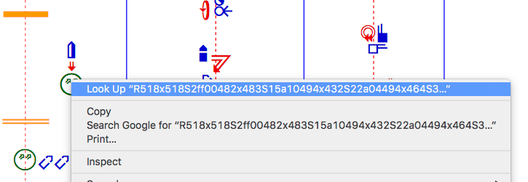
Formal SignWriting
Individual Sign Copy and Paste
Double-Click or Triple-Click an individual signs to select.
Use the Alternate-Click on the same sign for a menu to copy.
An individual sign may or may not appear selected.

Slide 13
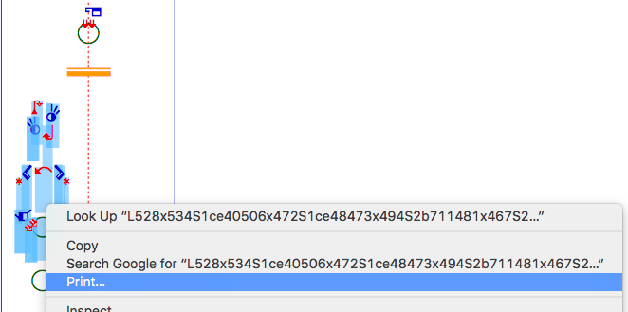
Formal SignWriting
Multiple Sign Copy and Paste
Using the mouse, click and drag to select several signs.
The FSW will be selected, possibly with plane 4 or 16 characters.

Slide 14
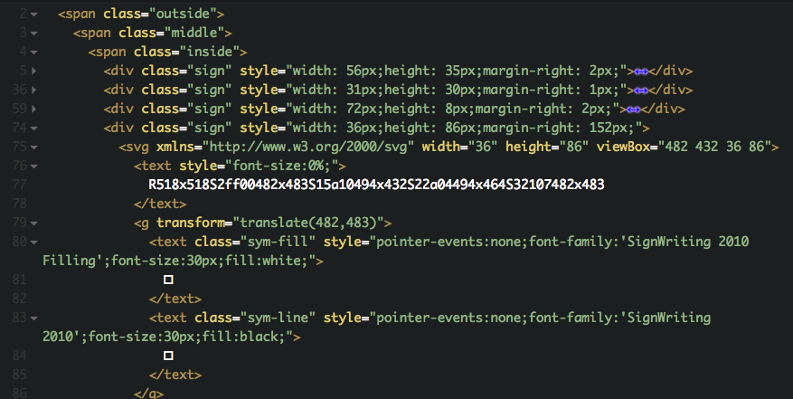
Formal SignWriting UTF-8 and Unicode Planes
HTML
FSW
source
coordinates
Unicode
Plane 4 or 16
for S2ff00
http://codepen.io/Slevinski/pen/zqGNqz

Slide 15
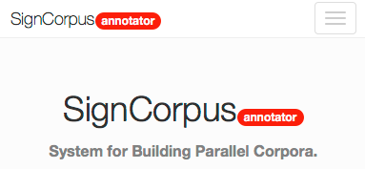
2016 Highlight - SignCorpus
Formal SignWriting
Web Interface
Generates flat file data
https://bitbucket.org/unipampa/signcorpus
A Web Tool for Building Parallel Corpora
of Spoken and Sign Languages.
http://www.signwriting.org/symposium/presentation0057.html

Slide 16
Imagine
Imagine a world in which every sign language user can freely share in the sum of all knowledge.

Slide 17
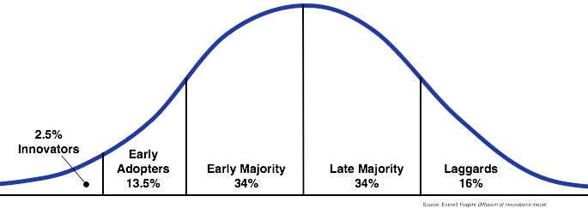
Innovation Adoption
The international SignWriting community is working towards
a future of written sign language for education and literature and more.
In Brazil, the early majority of Deaf embrace literacy.
Many can quickly write Sutton SignWriting by hand.
https://www.facebook.com/librasescrita/
32,523 Total Page Likes

Slide 18
Wikimedia
Wikimedia is a global movement whose mission is to bring free educational content to the world.
All of these projects can use sign language text encoded
in Formal SignWriting. Several projects are underway.

Slide 19
Realize
Sign languages are human languages. Any topic that can be discussed in a spoken language can be discussed in a signed language. It's important to realize the benefits of a person being able to access information in their primary language. It's exciting to realize that sign language wikipedia projects are now possible with Sutton SignWriting.

Slide 20
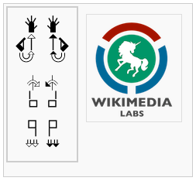
Wikimedia Labs
Wikimedia Labs provides server virtualization for community projects. SignWriting has an open-ended project involving several instances and websites.
https://wikitech.wikimedia.org/wiki/Nova_Resource:Signwriting
http://swis.wmflabs.org/
http://swserver.wmflabs.org/

Slide 21
Progress
For the past several years, we have been working on the technical infrastructure to make it possible to have a wikipedia in any sign language. We've been using Translate Wiki to localize the user interface. Most commonly, SignWriting is displayed vertically and for MediaWiki this requires a custom skin with the CSS vertical writing mode enabled. The technical details are complex, and we continue to make progress.

Slide 22
SignWriting Gadget and Keyboard
The SignWriting Gadget runs on Incubator and provides the ability to view and edit SignWriting within MediaWiki.
http://www.signwriting.org/symposium/presentation0041.html
https://incubator.wikimedia.org/wiki/MediaWiki:Gadget-Signwriting.js

Slide 23
Snowball
As we've seen with Wikipedia itself, there is a snowball effect with these types of projects. More people getting involved, leads to more people getting involved. One of the major factors holding back the widespread acceptance of SignWriting is having enough reading material available to make it worthwhile to learn SignWriting. The sign language wikipedia projects are important for the growth of SignWriting and the positive effects of the sign language wikipedias will benefit all sign language users far beyond just the particular wikipedia projects themselves.

Slide 24
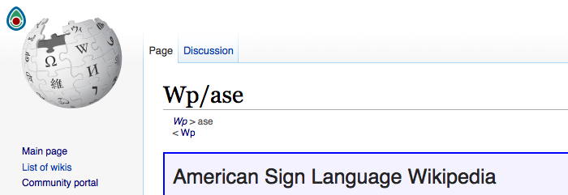
Wikimedia Incubator
Wikimedia Incubator provides a platform for new language projects to grow and develop a community.
https://incubator.wikimedia.org/wiki/Wp/ase

Slide 25
Spread the word
Sign language wikipedia projects are now possible with Sutton SignWriting. We encourage sign language users to get involved by learning Sutton SignWriting and the MediaWiki software. We encourage technical MediaWiki users of all levels to get involved and help us improve and streamline the technical details. We encourage everyone to imagine a world in which every sign language user can freely share in the sum of all knowledge.

Slide 26
Real World Impact
Moving forward with sign language projects under Wikimedia.
WikiConference USA
October 2016 in San Diego
https://meta.wikimedia.org/wiki/WikiConference_USA
Formal SignWriting
Adoption
Unicode
Considerations
SignWriting Encyclopedia Projects: Wikipedias in
American Sign Language and Tunisian Sign Language
http://www.signwriting.org/symposium/presentation0064.html

Slide 27
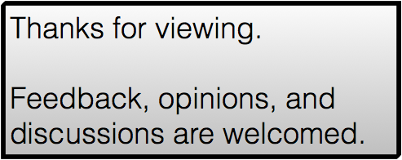
Moving Forward with
Sign Language Projects in
Formal SignWriting (FSW)
by Stephen E Slevinski Jr
slevinski@signwriting.org
AS20310S26b02S33100M521x547S33100482x483S20310506x500S26b02503x520
http://signpuddle.com
http://slevinski.github.io/

Slide 28
The standards process
Specifications
Real world usage
Implementations
A long digression into how standards are made…
Dive into HTML5 by Mark Pilgrim
http://diveintohtml5.info/past.html

Slide 29
The standards process
“Implementations and specifications have to do a delicate dance together. You don’t want implementations to happen before the specification is finished, because people start depending on the details of implementations and that constrains the specification. However, you also don’t want the specification to be finished before there are implementations and author experience with those implementations, because you need the feedback. There is unavoidable tension here, but we just have to muddle on through.”
Mozilla Developer
http://lists.w3.org/Archives/Public/public-html/2010Jan/0107.html

